Slide 1
Installation Guide
(IDE – Eclipse 3.4)
2008. 12. 09
CODELABOR

Slide 2
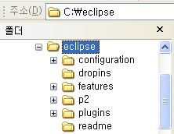
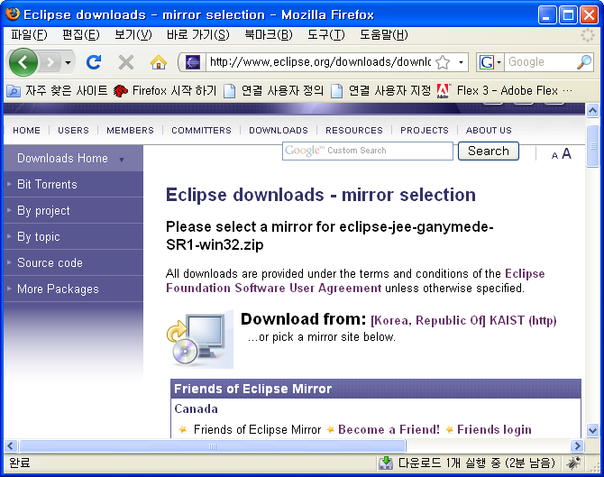
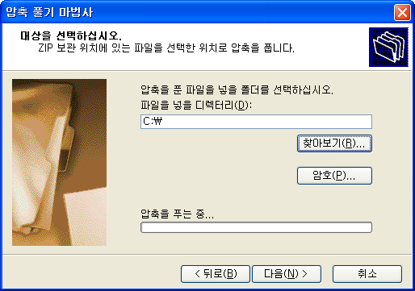

IDE
Installation
Official Site: http://www.eclipse.org/downloads/
File: eclipse-jee-ganymede-SR1-win32.zip
Unzip Directory: C:\
Installation Directory: C:\eclipse

Slide 3
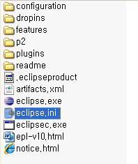
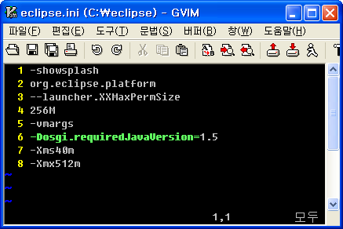
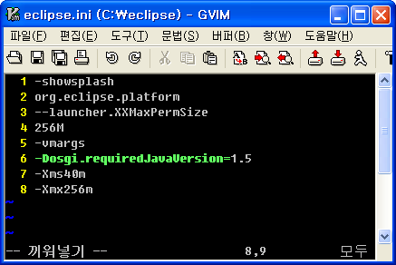
IDE
Configuration
Configuration File: eclipse.ini
Before: -Xmx512m
After: -Xmx256m

Slide 4
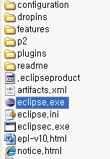


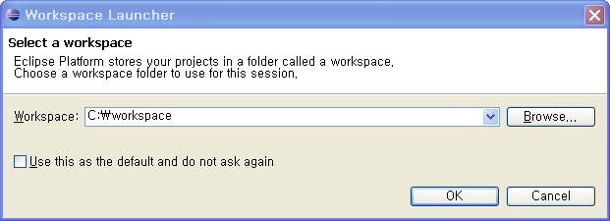
IDE
Run
Executable File: eclipse.exe
Workspace Directory: C:\workspace

Slide 5
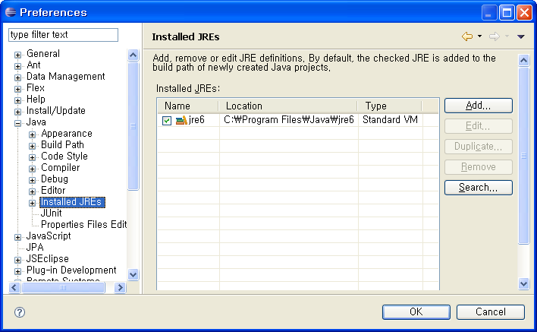
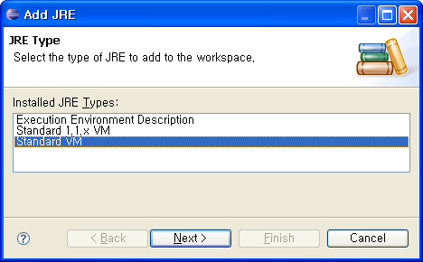
IDE
Installed JREs
Windows ＞ Preferences ＞ Java ＞ Installed JREs

Slide 6
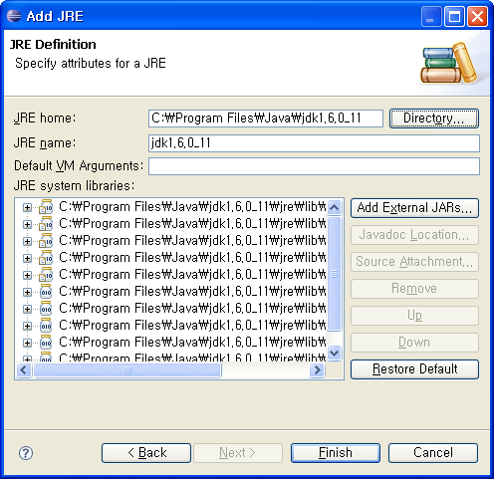
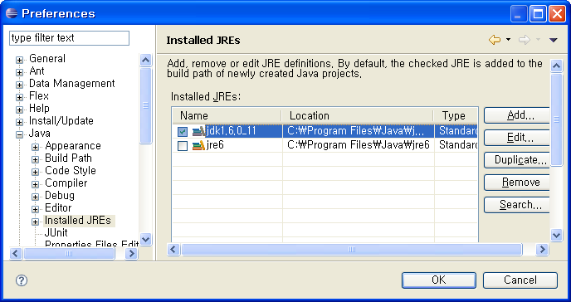
IDE
Installed JREs
Check jdk1.6.0_11

Slide 7
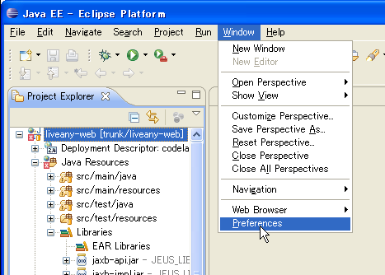
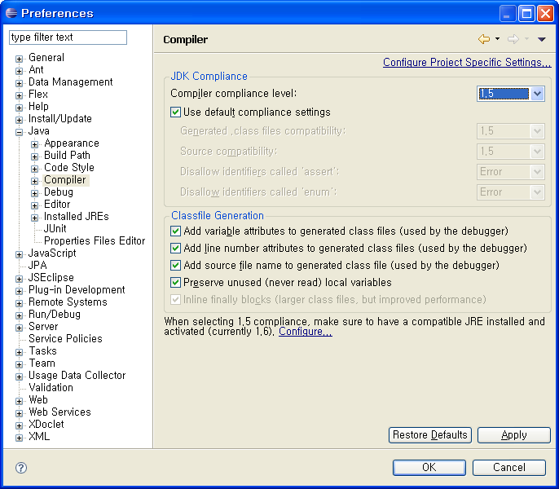
IDE
Compiler Compliance
Windows ＞ Preferences ＞ Java ＞ Compiler
Default Complicance Setting: 1.5

Slide 8
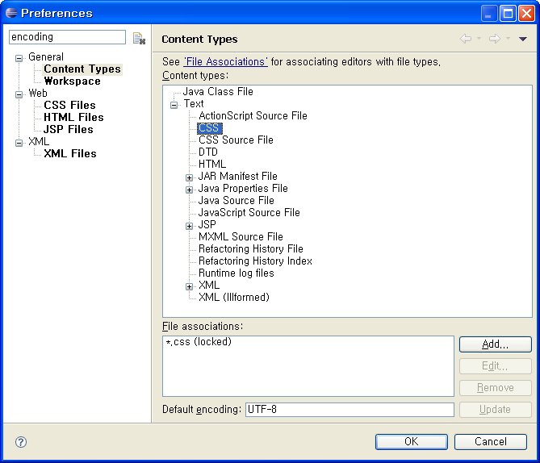
IDE
Encoding
Windows ＞ Preferences
Search Keyword: encoding
CSS: UTF-8
HTML: UTF-8
Java Properties File: ISO-8859-1
Java Source File: UTF-8
Java Script Source File: UTF-8
JSP: UTF-8

Slide 9
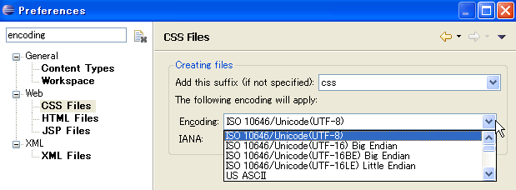
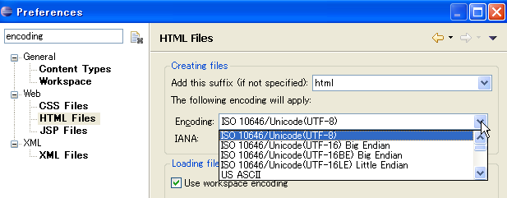
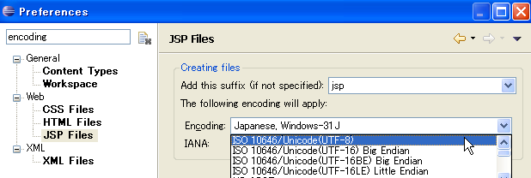
IDE
Encoding
CSS: UTF-8
HTML: UTF-8
JSP: UTF-8

Slide 10
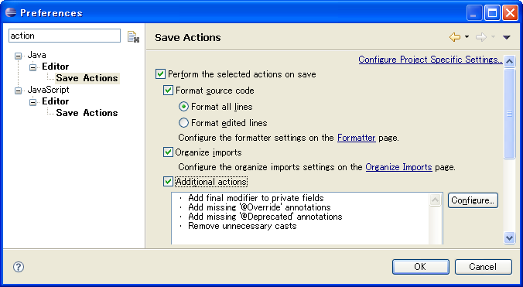
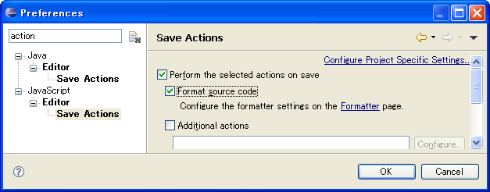
IDE
Save Action
Windows ＞ Preferences
Search Keyword: action
Format source code
Organize imports
Additional actions

Slide 11
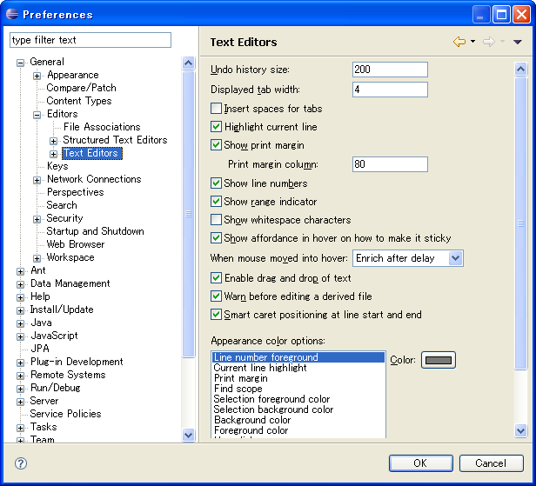
IDE
Text Editong
Windows ＞ Preferences > General > Editors > Text Editors
Show print margin
Show line numbers

Slide 12
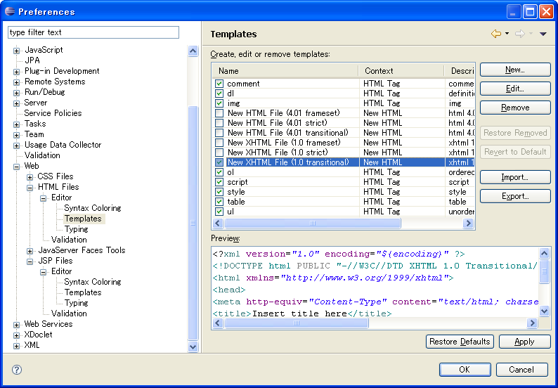
IDE
New File Template
Windows ＞ Preferences > Web > HTML Files > Editor > Template
HTML: XHTML 1.0 transitional

Slide 13
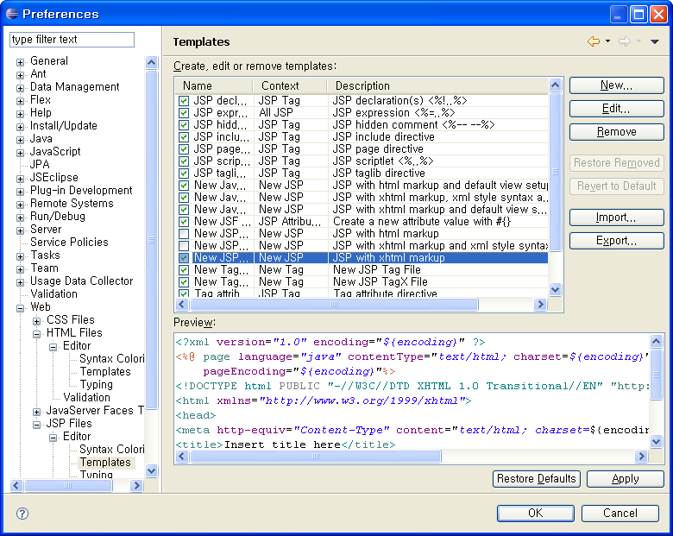
IDE
New File Template
Windows ＞ Preferences > Web > JSP Files > Editor > Template
JSP: XHTML 1.0 transitional

Slide 14
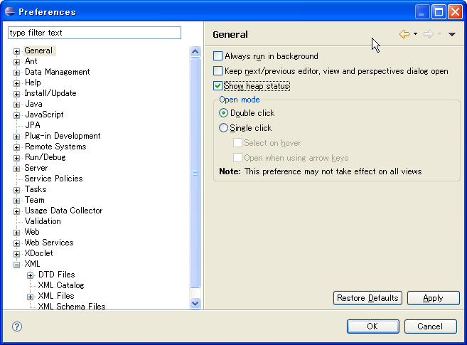

IDE
Heap Status
Windows ＞ Preferences > General
Show heap status

